Slide 1
2014 Dolores river restoration Rapid Monitoring and cottonwood suitability follow up
Prepared for the Dolores River Restoration Partnership by:
Katie Birch & Kristin Maier
October 2014
Notes:
K: We are an SCC strike team, a 2 member crew, recently 3 member. (shout out to Cbizz). I started with the Southwest Conservation Corp this June and studied and received a state licensure as a Qualified Supervisor to treat invasive species. In July, we transitioned to Rapid Monitoring. Kristin joined the team in September as we transitioned to secondary weeds treatments and maintenance along the Dolores river with the Tres Rios BLM.

Slide 2
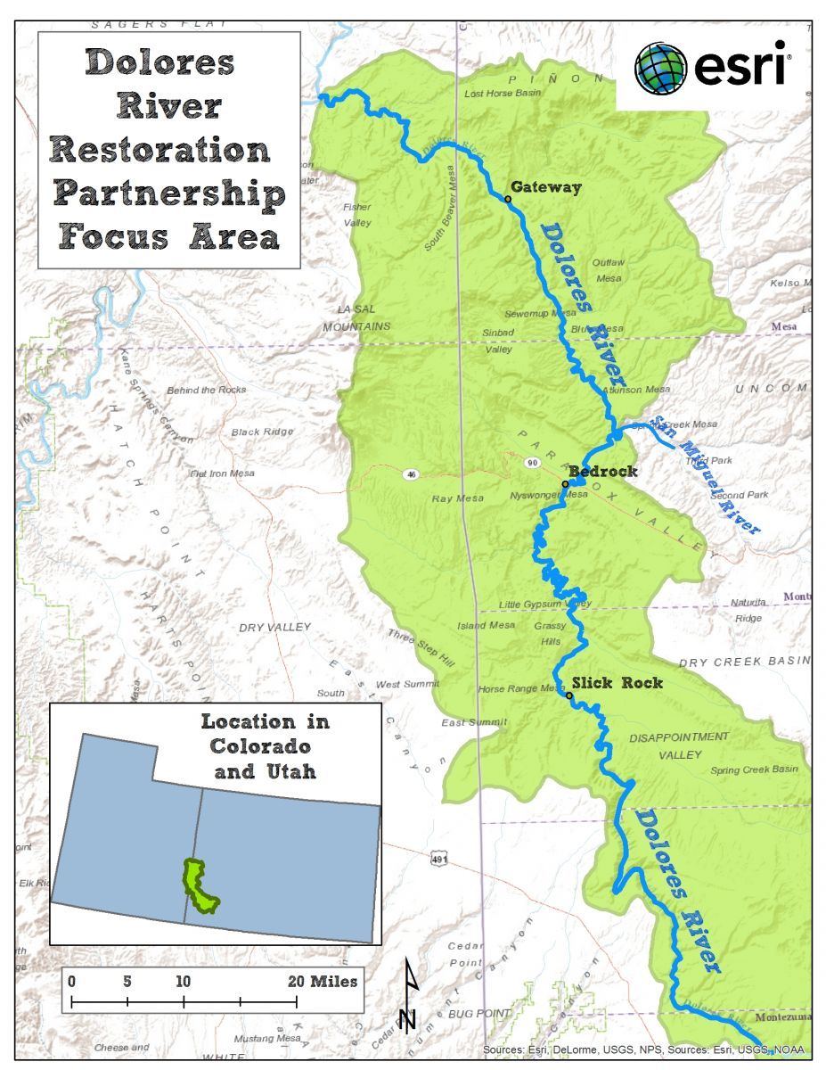
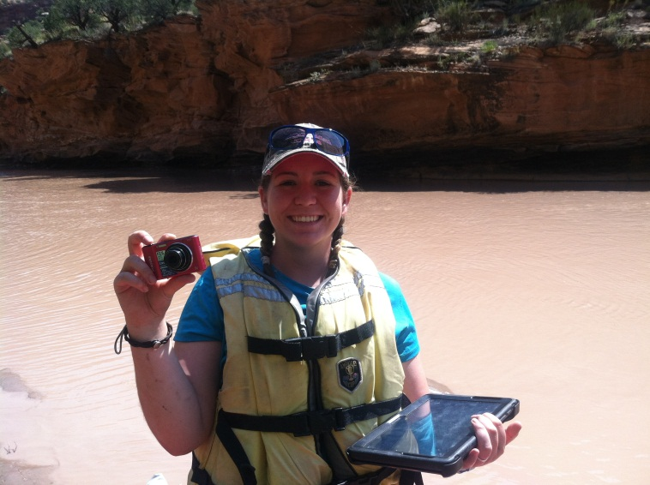
2014 Rapid Monitoring and Cottonwood Sites
Tres Rios (Dolores) BLM
Uncompahgre BLM
Grand Junction BLM
Moab BLM
Notes:
K: Our work focused in these 4 BLM territories doing Rapid Monitoring, inventory and follow up. Our goal was to assess vegetative status after initial tamarisk removal. We used a new mapping program (MapItFast) to collect data about relative canopy cover and presence of native and invasive species. Additionally, we took photos at designated points to show visual progress that has occurred since 2011.
S: Another component of this monitoring was follow up to the Cottonwood Suitability Project. We visited the cottonwood sites to determine whether plantings were alive. We watered struggling cottonwoods and tagged cottonwoods with appropriate test pit numbers so data can be analyzed down the road.

Slide 3
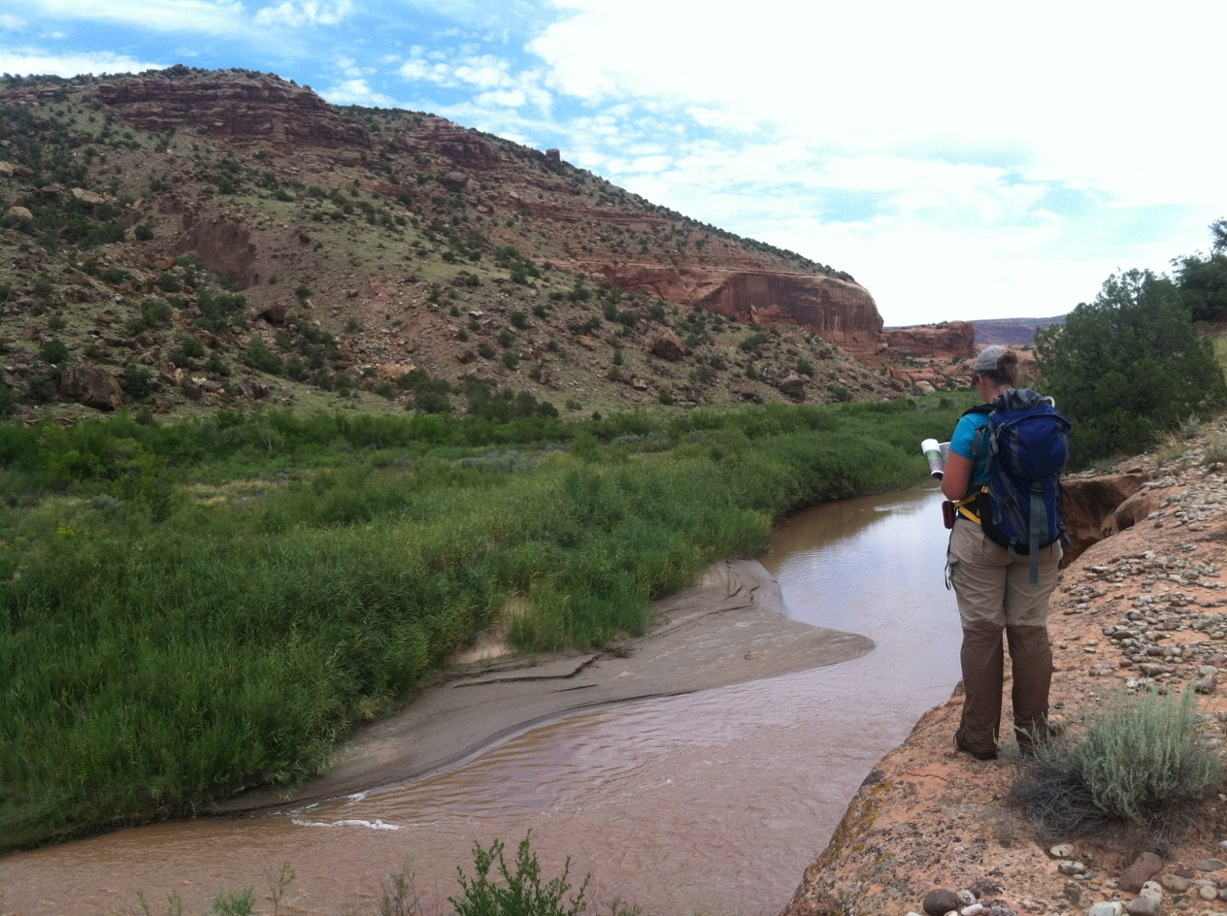
Tres Rios BLM Field Office
Rapid Monitoring
Big Gypsum
Little Glen 1 & 2
Nicholas Wash
Disappointment Creek
Biocontrol Site 2 **Newly established this year
No cottonwood plantings
Notes:
K: In the Tres Rios BLM, our work focused primarily on rapid monitoring at these sites. This fall we are treating weeds at Disappointment and Big Gypsum.

Slide 4
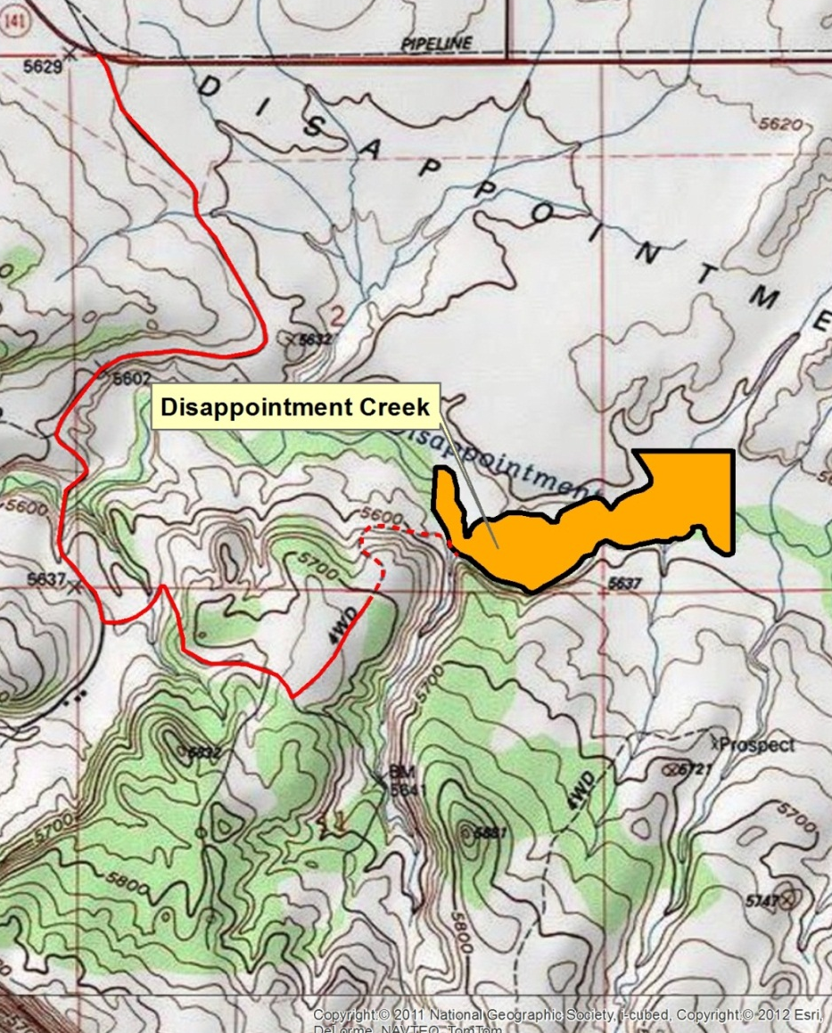
Tres Rios BLM Disappointment Creek
Notes:
S: Disappointment Creek has considerable impacts on the Dolores River in terms of invasive seed source, fine sediments, and flows. During rapid monitoring, we found…

Slide 5
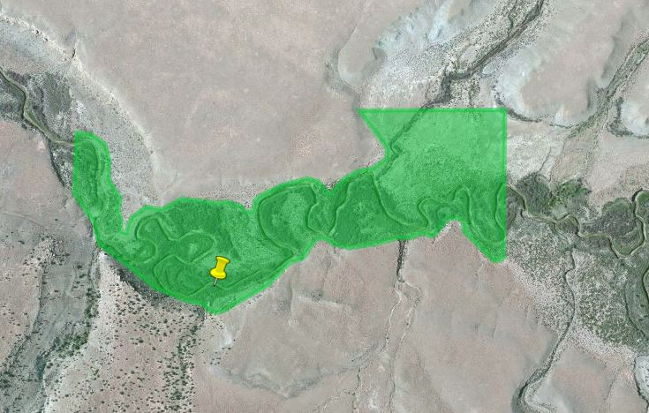
Disappointment Creek Findings
2014 Progress Reporting Status
• Native/desirable species cover 31-50% of site
• Tamarisk covers 16-30% of site
• All other non-natives cover 16-30% of site
• Tamarisk beetle observed. Signs of defoliation include dropped foliage and distressed mature tamarisk
Canada thistle infestation
Russian knapweed scattered throughout site at an average density of 15%
Notes:
S: Russian Knapweed is a big concern infesting lower and higher banks at an average density of 15%. Disappointment Valley is a large upstream contributor for Knapweed and Tamarisk seeds which is why it was made a priority for fall treatments. With our in-the-field software, we were able to drop points at small infestations, like this Canada Thistle, allowing us to return to this specific infestation for fall treatments.

Slide 6
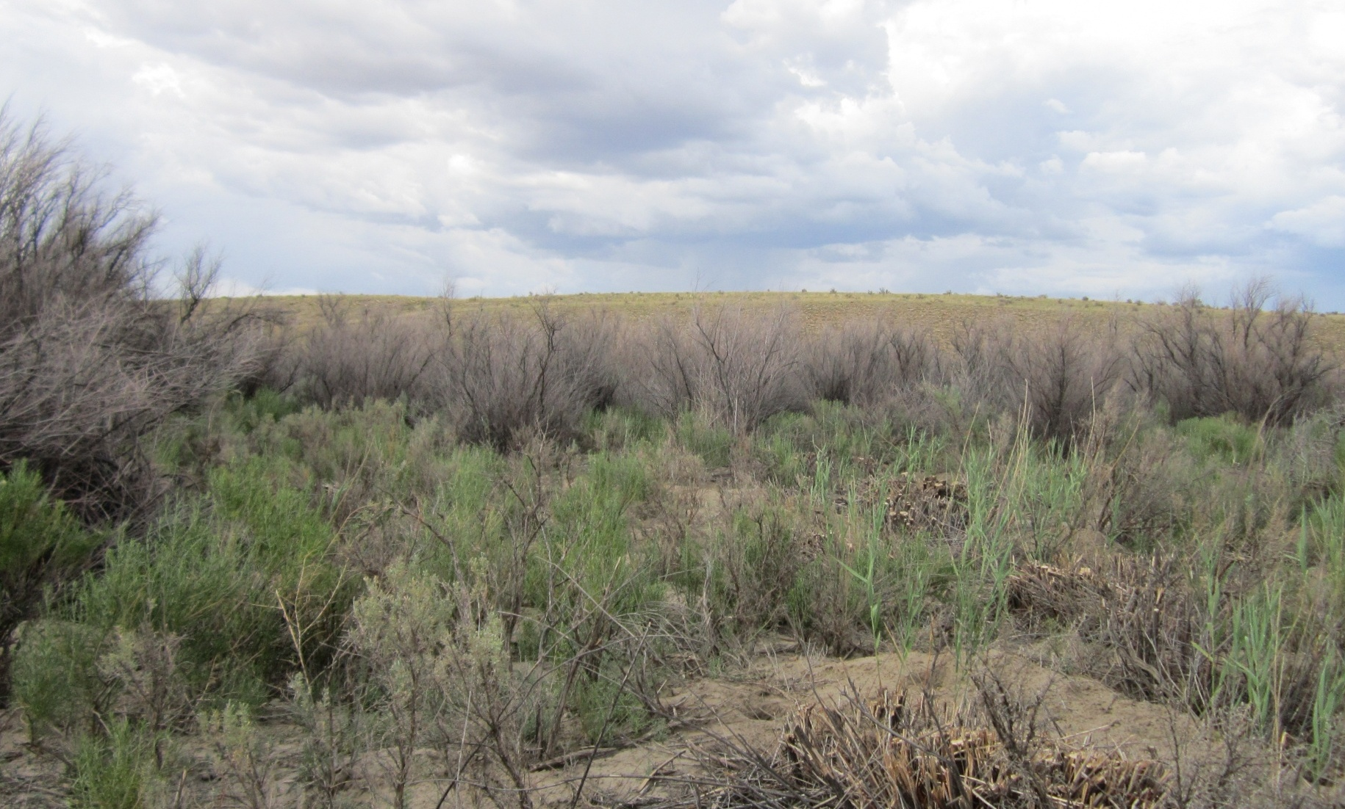
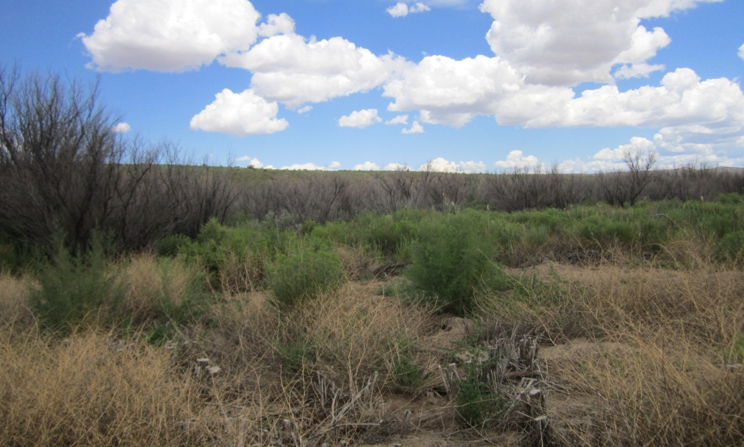
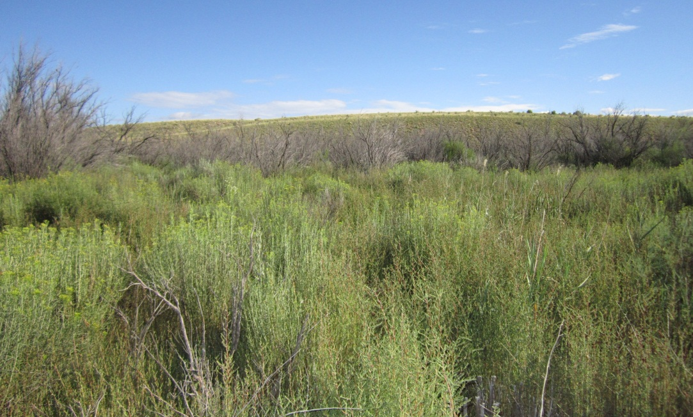
Disappointment Creek Photos
2011
2013
2014
Notes:
K: 2011: Tamarisk cuttings and defoliated tamarisk in background.
2013: Rabbitbrush and tamarisk resprouts.
2014: Rabbit brush & scattered phragmite, invested with kochia. Defoliated tamarisk in background.

Slide 7
Tres Rios BLM Big Gypsum
Notes:
S: Big Gypsum was another site we monitored and are now following up with secondary weed treatments.

Slide 8
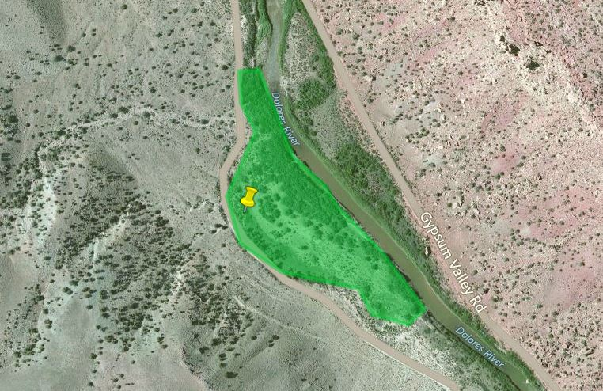
Big Gypsum Findings
• Tamarisk resprouts were present at a density of 1-4% throughout site
• Kochia dominant on northeast perimeter
2014 Progress Reporting Status
• Native/desirable species cover 31-50% of site
• All other non-natives cover 51-75% of site
• Beetle defoliation present; most prominent on mature tamarisk stands
• Total vegetation canopy cover is more than 75% of site
Russian knapweed infestation, scattered across site along SE perimeter in average densities of 50-80% in this area. Thinning to an overall density of approximately 1% across site
Notes:
S

Slide 9
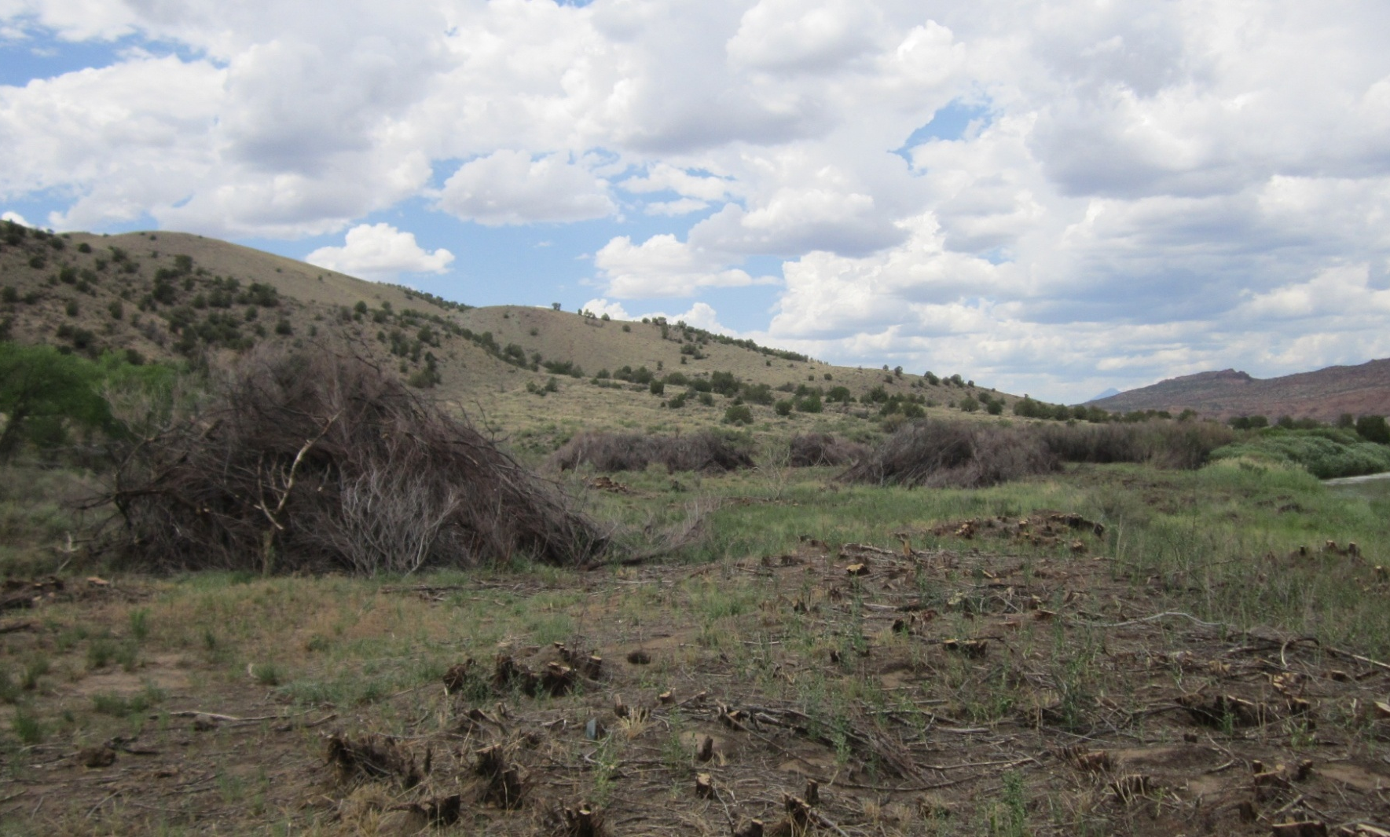
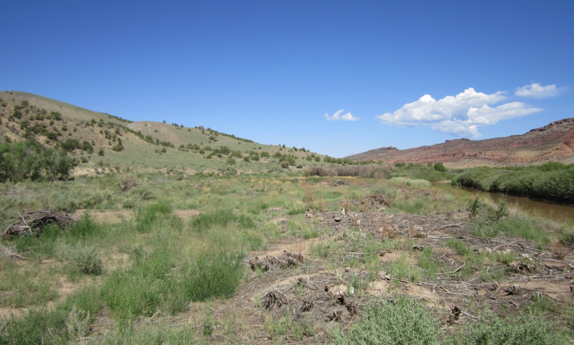
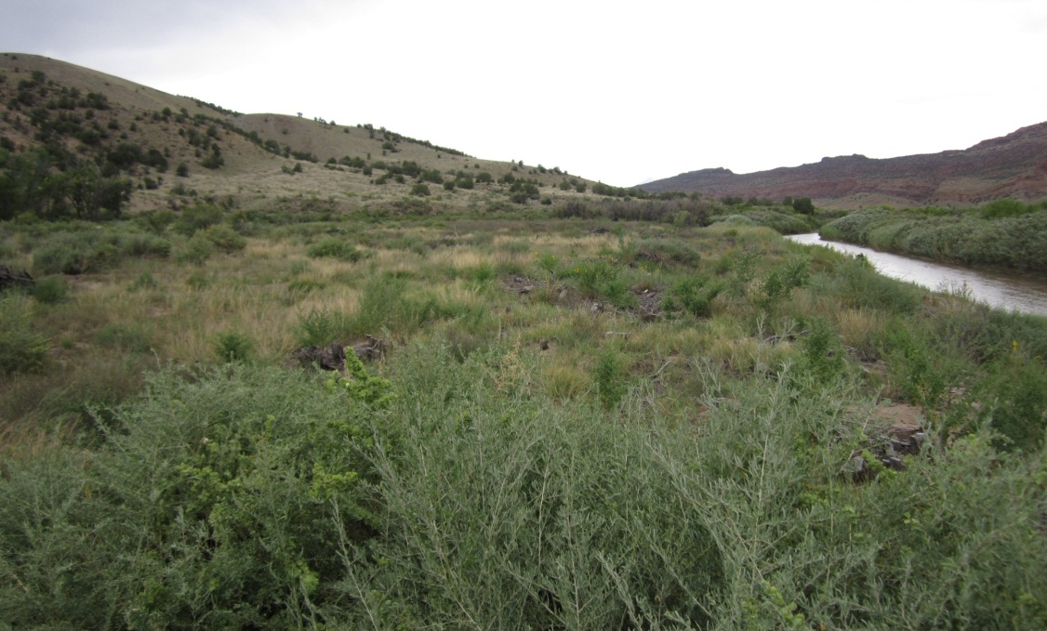
Big Gypsum Photo Progress
2011
2013
2014
Notes:
K: 2011: Tamarisk cuttings and piles. Very few tamarisk resprouts.
2013: Slash piles burned and some Kochia growing in . Defoliated tamarisk resprouts (right center).
2014: Passive revegetation by native grasses and 4-leaf salt bush. Heavy kochia population invading burn areas.

Slide 10
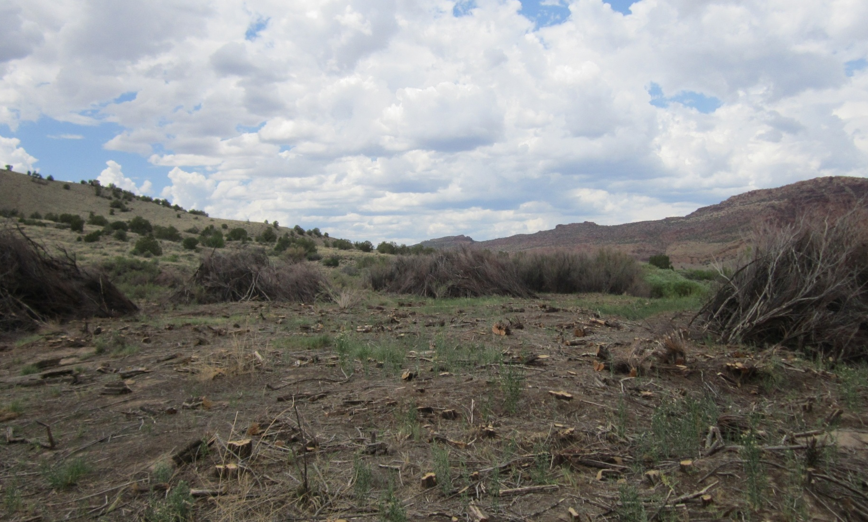
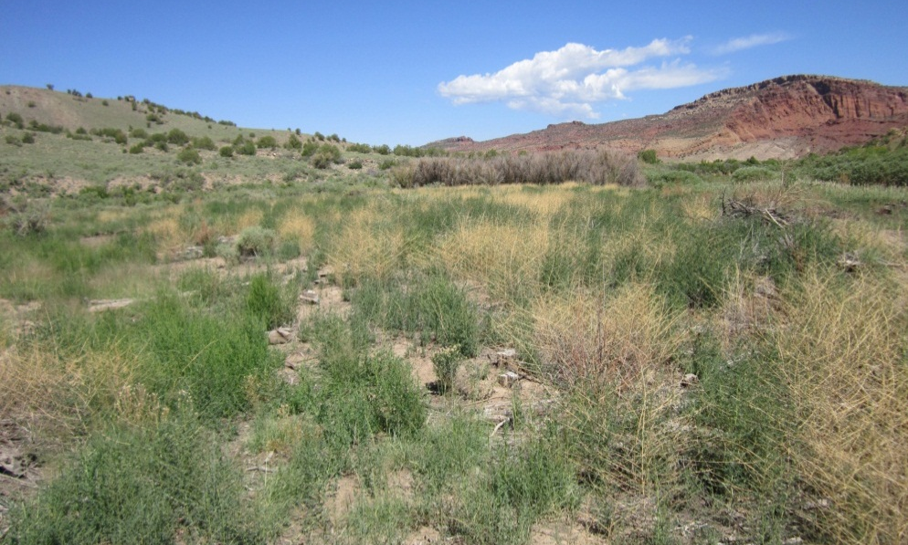
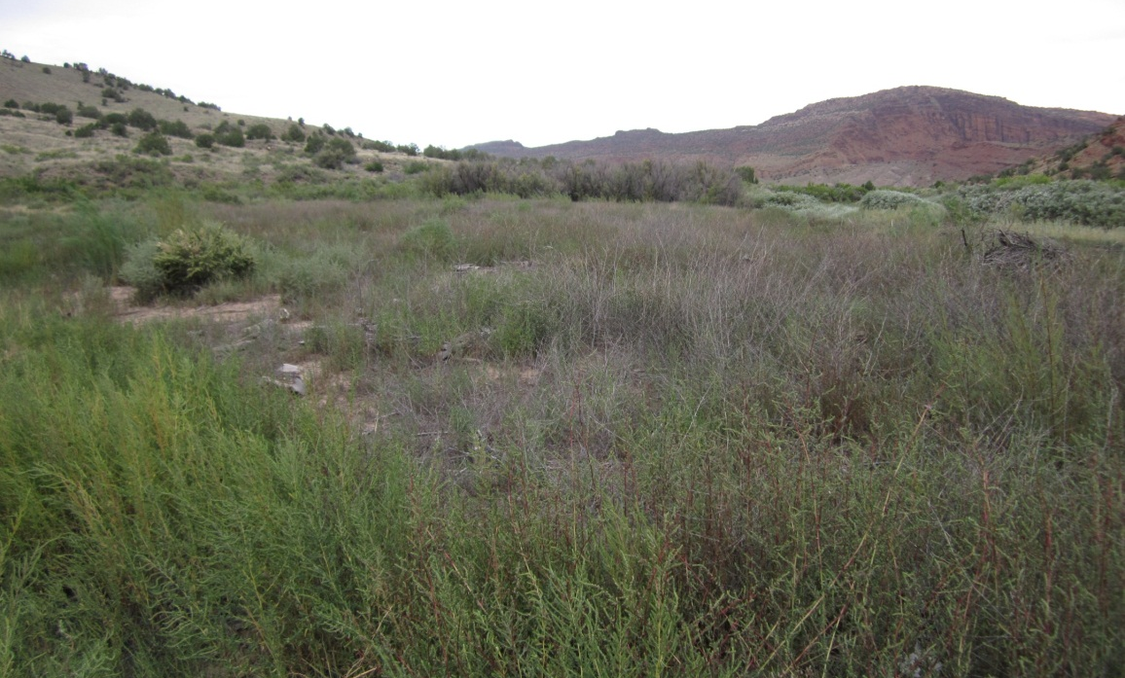
Big Gypsum Photo Progress
2013
2011
2014
Notes:
K: 2011: Tamarisk cuttings and piles. Very few tamarisk resprouts. A lot of barren areas
2013: Tamarisk removal filled in heavily with Kochia and Russian Knapweed.
2014: Knapweed infestation treated.

Slide 11
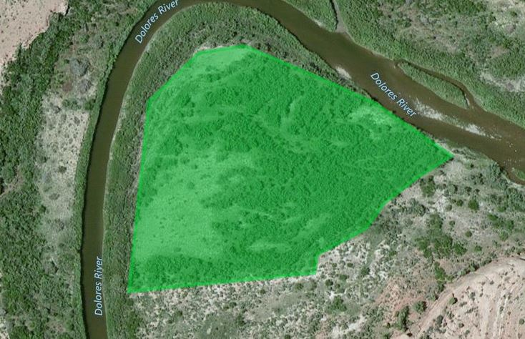
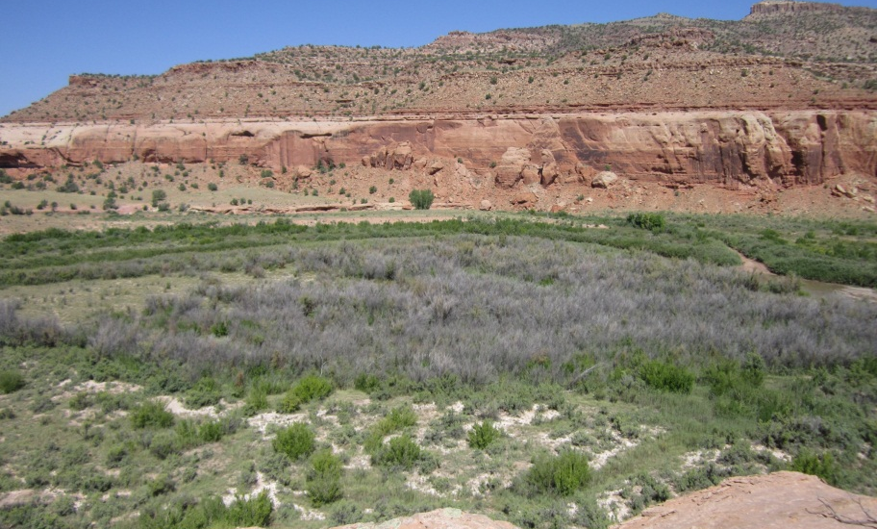
Tres Rios Biocontrol (Site 2)
BLM Office: Tres Rios (Dolores)
Driving from Slickrock, on river right side. Park at top of knob (Windy Point) to hike down old buckboard trail to site, cross river near LG1 and then again across from BC site
BC 2
Notes:
K: Details on the other sites and new biocontrol sites can be found in the 2014 Rapid Monitoring Reports distributed by the Tamarisk Coalition.

Slide 12
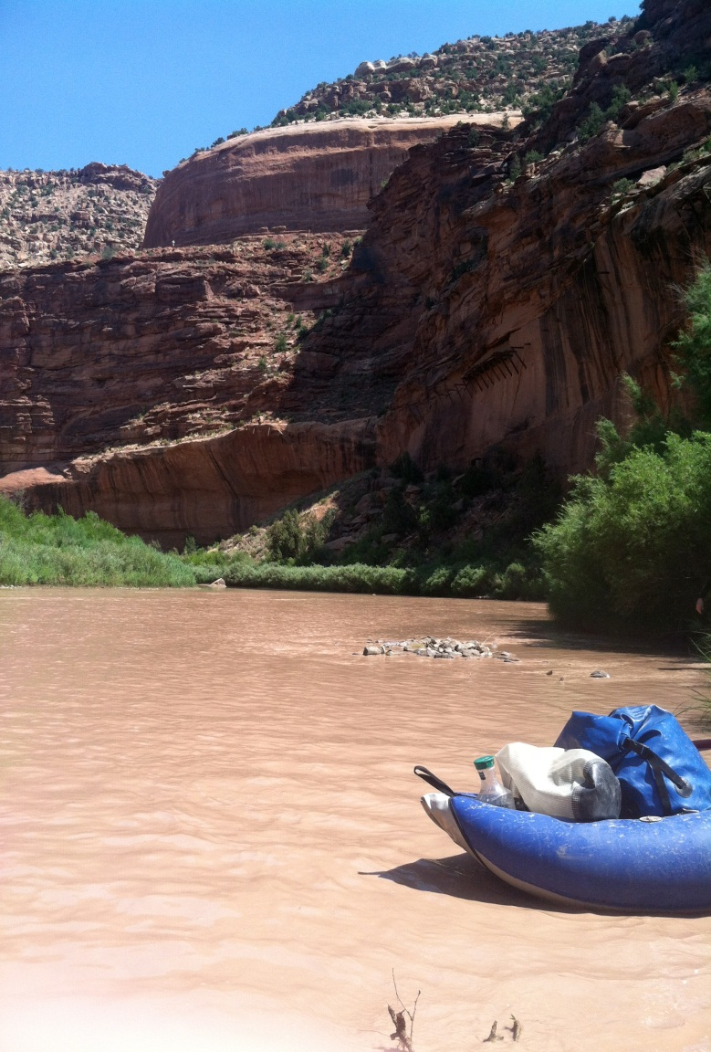
Uncompahgre BLM Field Office
Rapid Monitoring
Dolores River Rapid Monitoring Stretch
109A, 109B, 110A,110B, 111A, 111B, 112B
San Miguel River Monitoring Stretch
Biocontrol 3 & 4
Cottonwood Suitability Follow Up
Boat Ramp
Bridge Test 1 & 2
Hwy 141 Test
Notes:
S

Slide 13
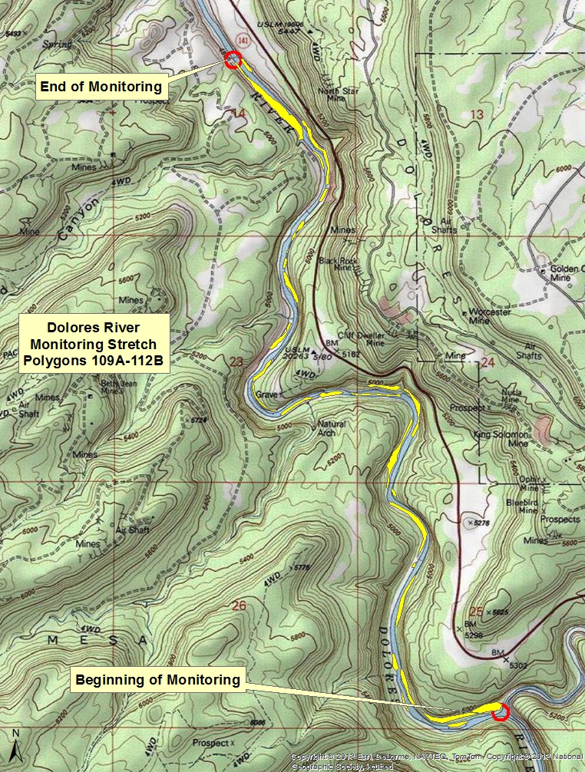
Polygons 109A-112A (formerly known in 2012 as the Dolores River (DR) Monitoring Stretch)
Notes:
K: Overall, non-native coverage is decreasing through treatments and biological controls. The tamarisk beetle has been active defoliating live tamarisk along this stretch of river. Some new invasives like Siberian elm and pervasive invasives (cheatgrass, knapweed, kochia) were found on the stretch. See 2014 Rapid Monitoring Report for this data.

Slide 14
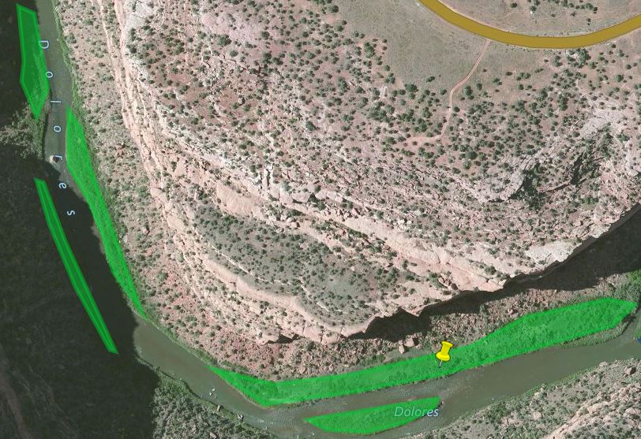
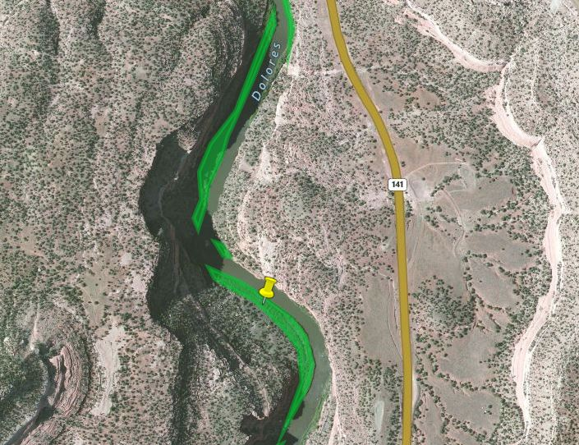
Uncompahgre BLM : Infestation Mappings
109a weed wt
110a weed rk
Notes:
K: As part of our Rapid Monitoring, we dropped points where there were obvious epicenters of infestations so these areas could be targeted and treated in the future.

Slide 15
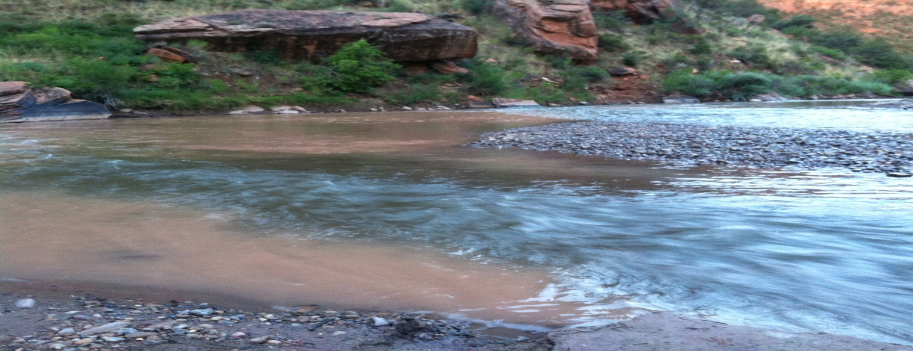
San Miguel River
Notes:
S: We monitored the San Miguel river upstream of its confluence with the Dolores River.

Slide 16
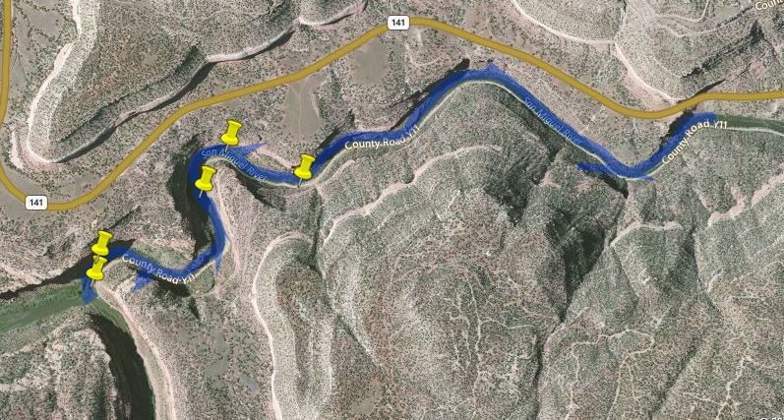
Insert aerial image PDF here
San Miguel River Mapped Infestations
rm_smr_weed_tamarisk1
rm_smr_weed_rk1
rm_smr_weed_tamarisk2
• Live tamarisk covers approximately 1-4% of this site
• Siberian elm prevails, covering approximately 1-4% of this site awaiting treatment
• Russian olive tree found on site
• Russian knapweed scattered across site in patches at relatively low densities (1-4%)
rm_smr_weed_rotree1
rm_smr_weed_kochia1
Notes:
S: Note we: did not map the Siberian elm

Slide 17
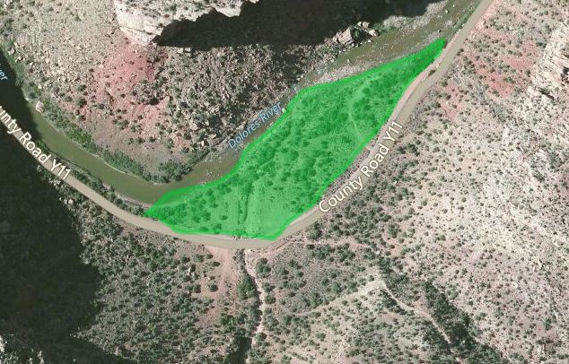
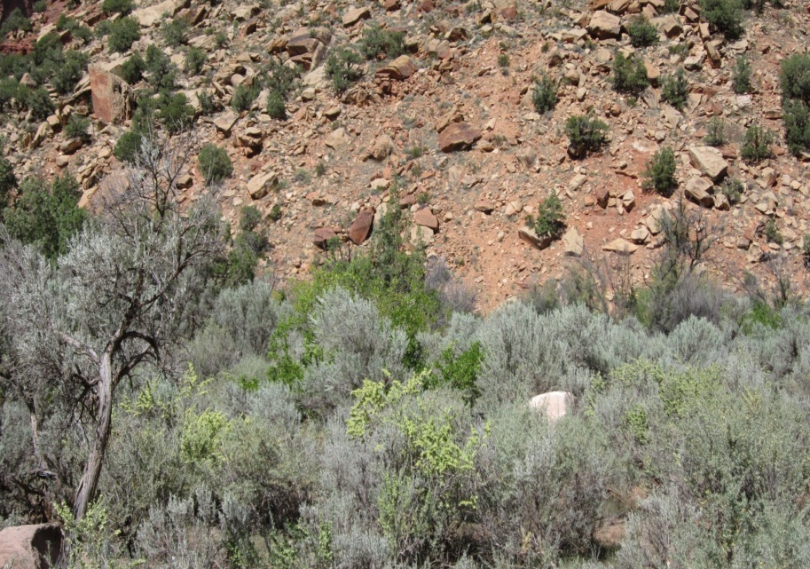
Uncompahgre BLM Biocontrol Site 3
Access to Uncompahgre Biocontrol sites from road Y11 upstream of confluence
Notes:
K: Baseline photo points and monitoring data

Slide 18
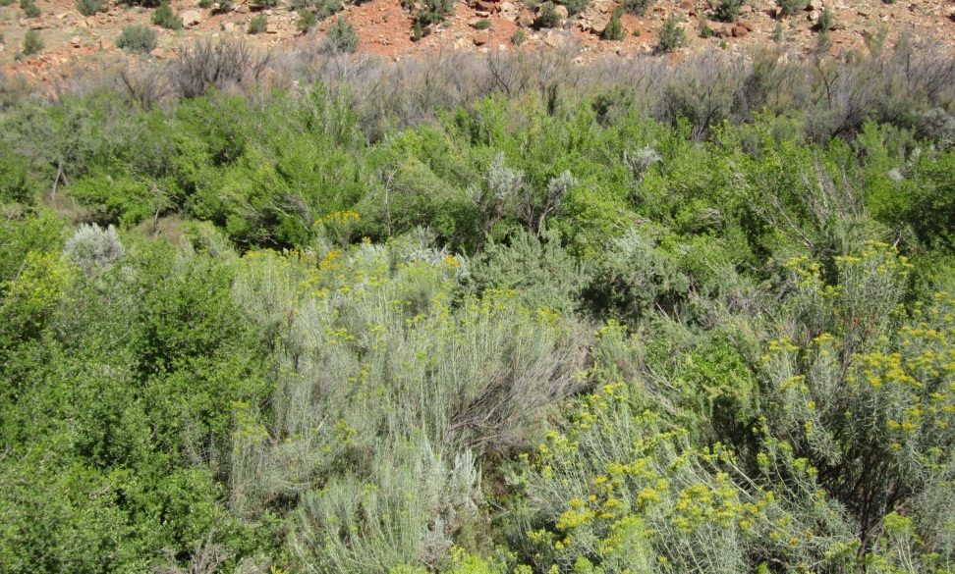
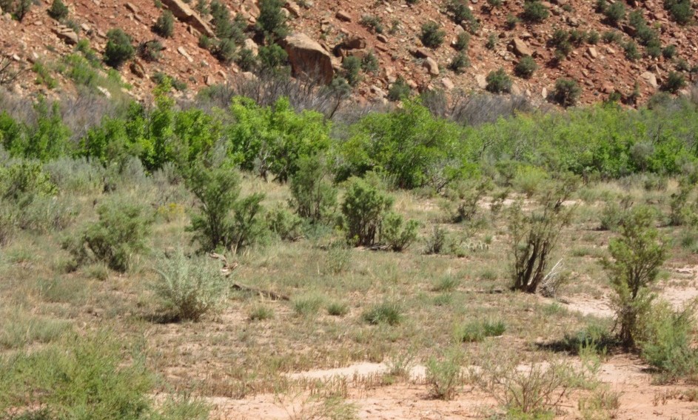
Uncompahgre BLM Biocontrol Site 4
Notes:
K

Slide 19
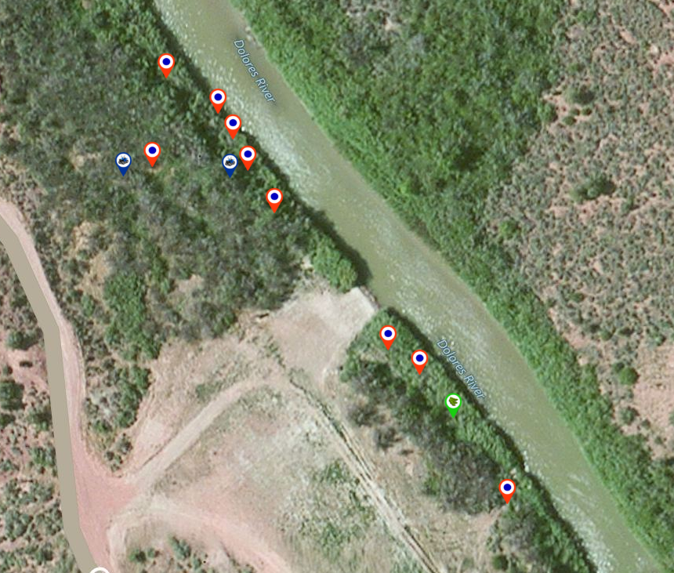
Uncompahgre BLM Cottonwood Follow Up : Boat Ramp
1 out of 10 plantings found alive
GW depth
Well 1: 7.7 ft
Well 2: 10.1 ft
Well 2
Well 1
Red = dead
Green = alive
Blue = GW well
Notes:
S

Slide 20
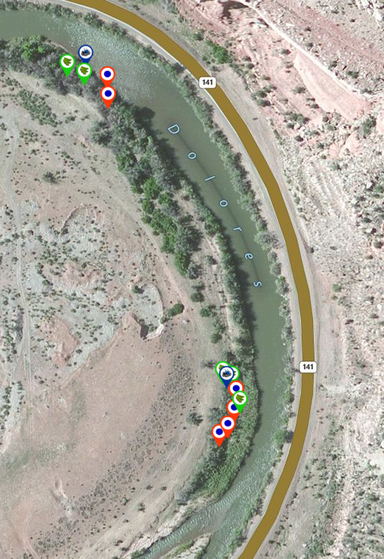
Uncompahgre BLM Cottonwood Follow Up : Bridge Test
5 out of 11 plantings found alive
GW depth
Bridgetest well 1: 8.3 ft
Bridgetest well 2: 7.8 ft
Bridgetest 2
Red = dead
Green = alive
Blue = GW well
Bridgetest 1
Notes:
S

Slide 21
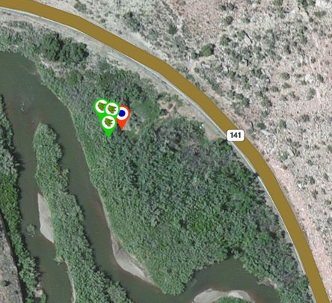
Uncompahgre BLM Cottonwood Follow Up : HWY 141
3 out of 4 plantings found alive
No groundwater monitoring well installed on this site
Cottonwood plantings at this sites were tagged
Red = dead
Green = alive
Bridgetest 2
Bridgetest 1
Notes:
S

Slide 22
Grand Junction BLM Field Office
Rapid Monitoring
Biocontrol 1
Cottonwood Follow Up
139NorthRR
OP 2
OP 7
CCBLM04
Notes:
K

Slide 23
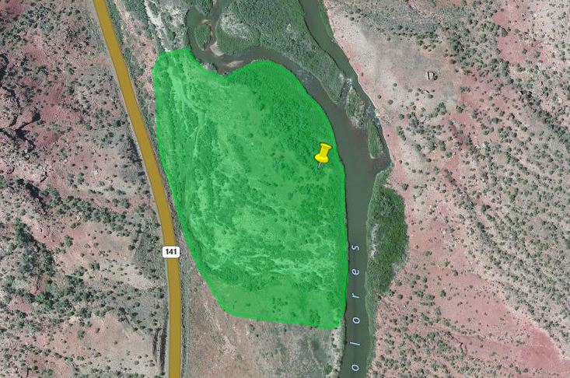
Grand Junction Biocontrol 1
Live tamarisk covers approximately 16-30% of site
Russian knapweed scattered across site, density of infested areas approximate 30-50%
Notes:
K

Slide 24
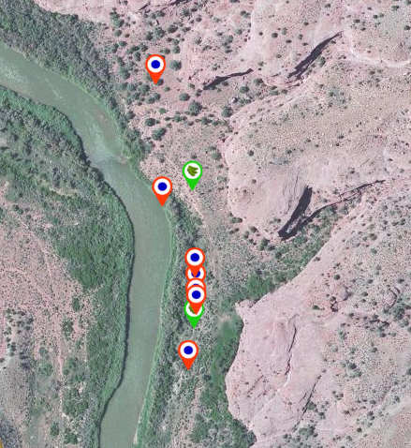
Grand Junction BLM Cottonwood Follow Up : 139NorthRR
2 out of 9 plantings found alive
No groundwater monitoring wells installed on this site
Bridgetest 2
Bridgetest 1
Red = dead
Green = alive
Notes:
S

Slide 25
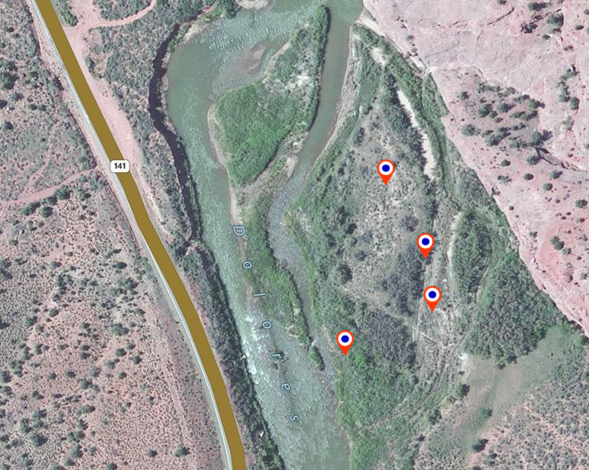
Grand Junction BLM Cottonwood Follow Up : OP2
0 out of 4 planting found alive
No groundwater monitoring well installed on this site
Caging was tagged with appropriate test pit numbers
Bridgetest 2
Bridgetest 1
Red = dead
Green = alive
Notes:
S

Slide 26
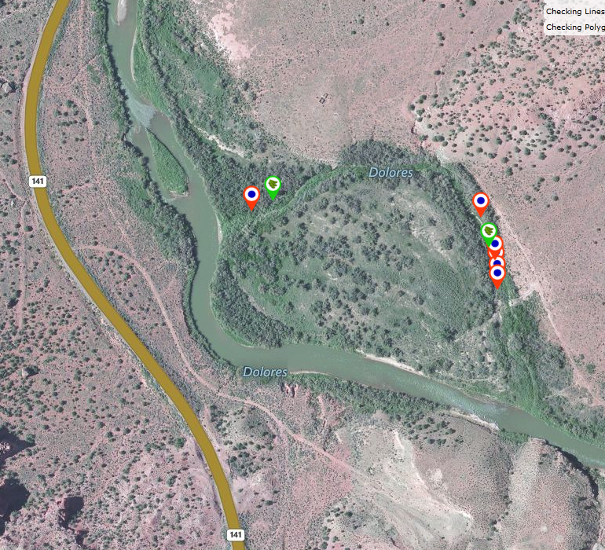
Grand Junction BLM Cottonwood Follow Up : OP7
2 out of 8 planting found alive
No groundwater monitoring well installed on this site
Caging was tagged with appropriate test pit numbers
Bridgetest 2
Bridgetest 1
Red = dead
Green = alive
Notes:
S

Slide 27
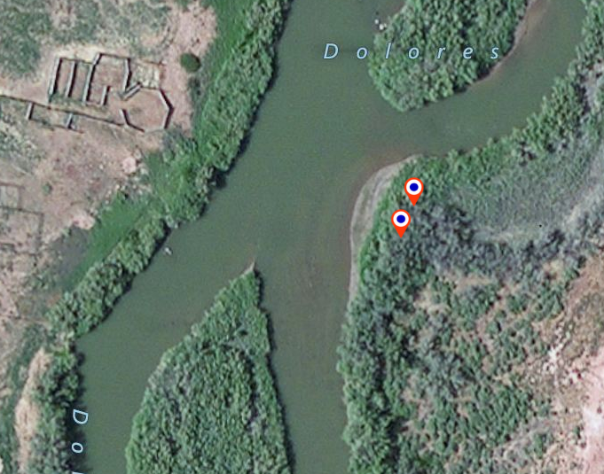
Grand Junction BLM Cottonwood Follow Up : CCBLM04
0 out of 2 plantings found alive
No groundwater monitoring well installed on this site
Bridgetest 2
Bridgetest 1
Red = dead
Green = alive
Notes:
S

Slide 28
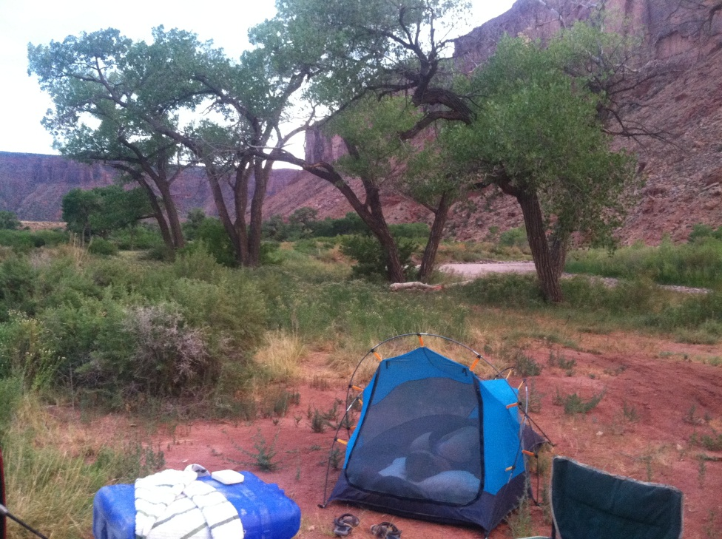
Moab BLM Field Office
Rapid Monitoring
MOR1 & 2 merged
MOR3
MOR4
Roberts Bottom 1
Roberts Bottom 2
Cottonwood Follow Up
Rio Mesa Research Station
Notes:
S

Slide 29
Moab BLM : MOR 1 & 2
• Tamarisk resprouts prevail, covering approximately 16-30% of this site
• Russian knapweed scattered throughout this site with an average density of 20% but up to 80% in infested areas
• Mature Russian olive tree patch found on east end of site
Passive Revegetation
•Successful revegetation in weed treatment areas
2014 Progress Reporting Status
• Native/desirable species cover 31-50% of site
• All other non-natives cover 31-50% of site
• Tamarisk beetle left tamarisk significantly defoliated and with considerable discoloration of leaves
• Total vegetation canopy cover is more than 75% of site
Notes:
K

Slide 30
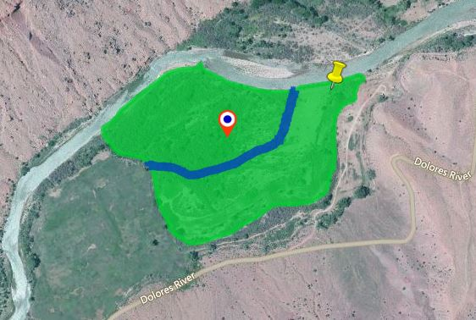
Insert aerial image PDF here
MOR 1 & 2 Mapping
rm_mor1_rotree
rm_mor1mor2_reveg
Notes:
K: Active cottonwood plantings done in past years were not found (with the exception of this one dead tree). They weren’t caged or gps’d so follow up was difficult.
Russian Olive Tree patch was found onsite.

Slide 31
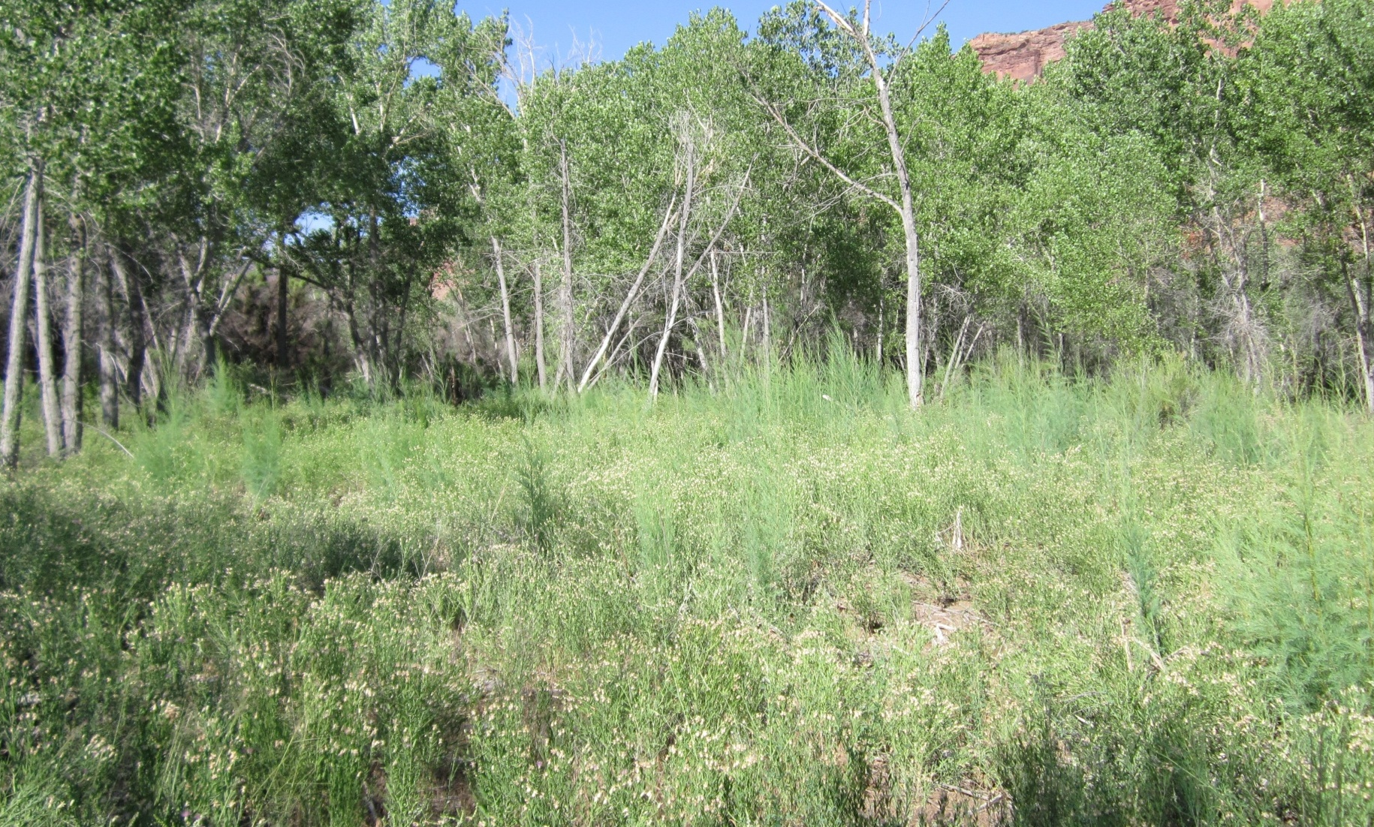
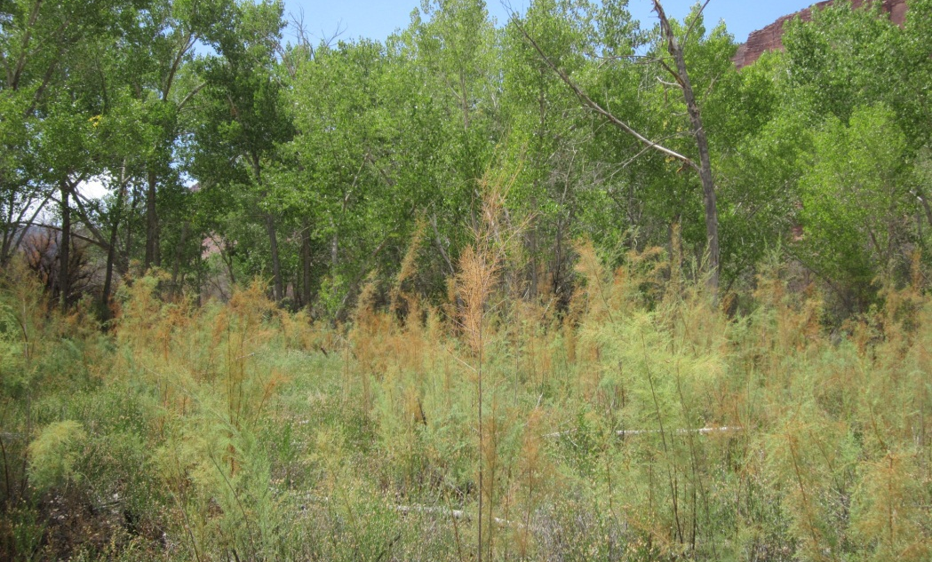
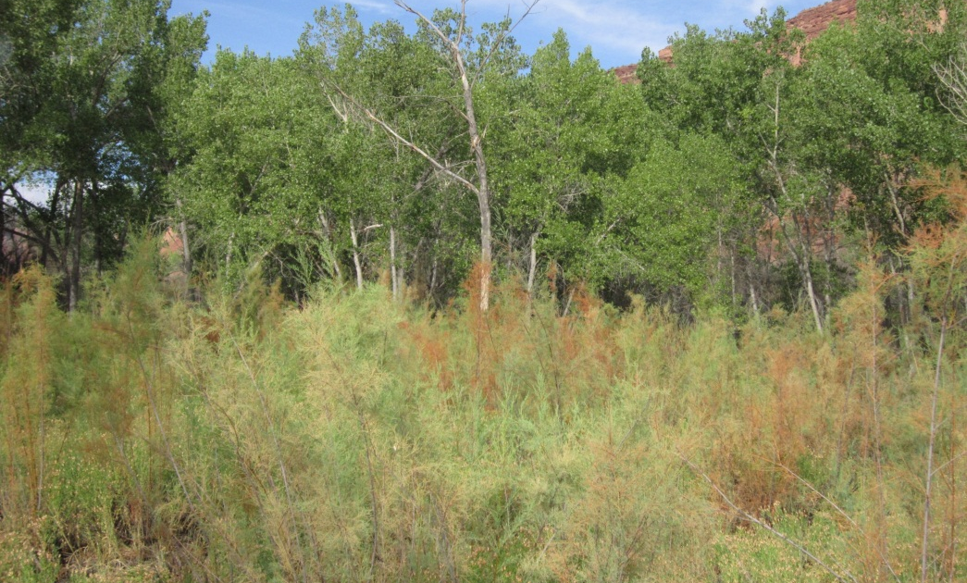
MOR 2 Photo Progress
2011
2013
2014
Notes:
K: 2011: Russian knapweed field
2013: Russian knapweed field with Defoliated tamarisk resprouts
2014: Defoliated resprouts losing density

Slide 32
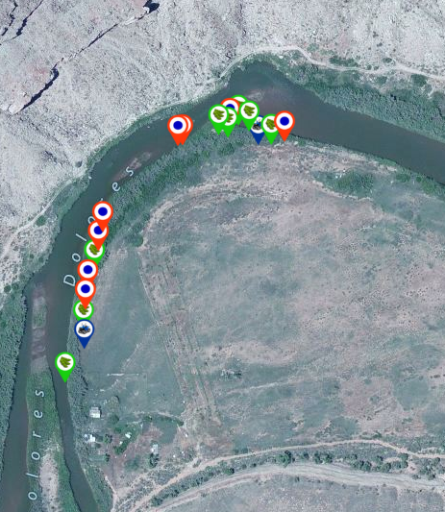
Moab BLM Cottonwood Follow Up : Rio Mesa
8 out of 16 plantings found alive
GW Depth:
Well 1: 7.4 ft
Well 2: 6.0 ft
Trees in Group 1 were identified and tagged with appropriate test pit numbers
Bridgetest 2
Well 1
Well 2
Bridgetest 1
Red = dead
Green = alive
Blue = GW well
Notes:
S

Slide 33
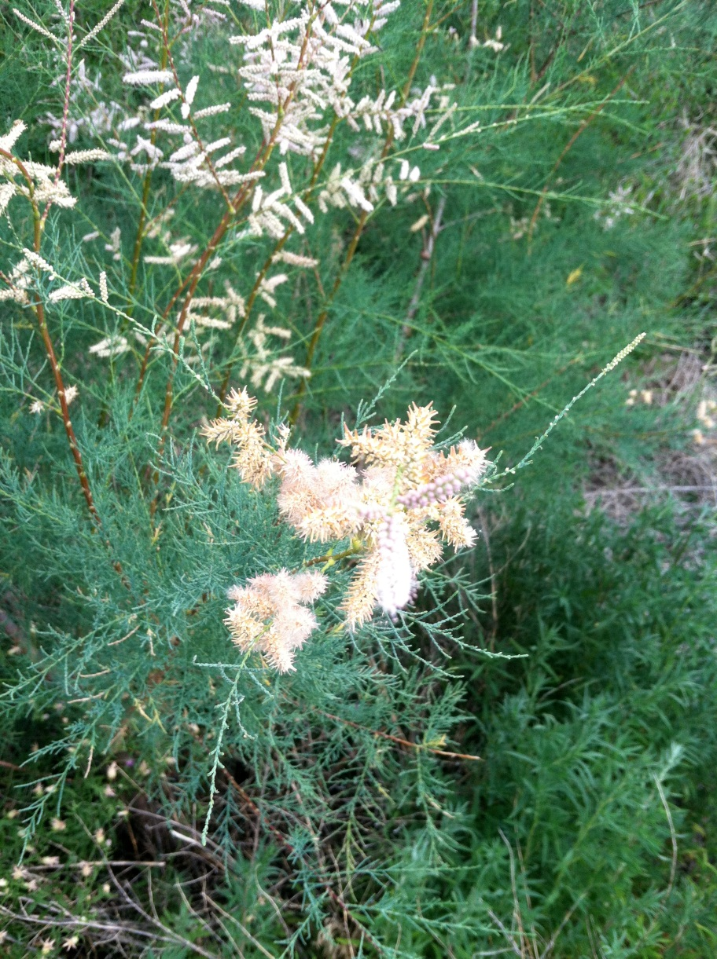
Questions?
Notes:
K: Overall, we saw a great amount of progress in the total canopy cover occupied by invasive species. Passive revegetation by native grasses and forbs is occurring and tamarisk removal and defoliation has been effective throughout the watershed.

